Slide 1
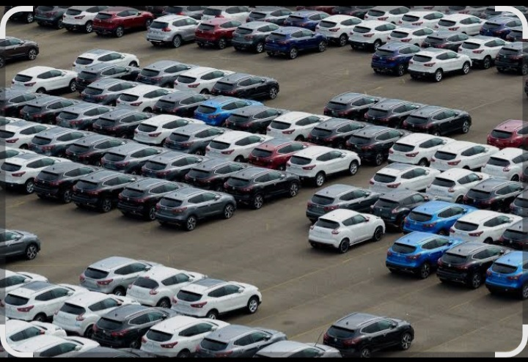
CAR SALES ANALYSIS

Slide 2
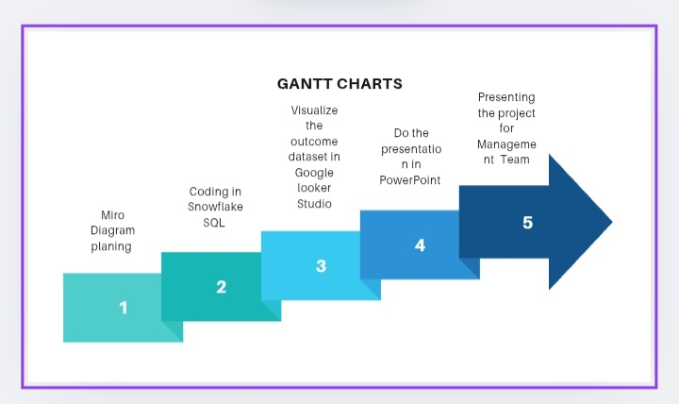

Slide 3
TABLE OF CONTENT
Gantt Charts……………………………………………….. 2
Miro Diagram……………………………………………… 3
SQL…………………………………………………………….. 5
Dashboard………………………………………………….. 6
Recommendations……………………………………… 9

Slide 4
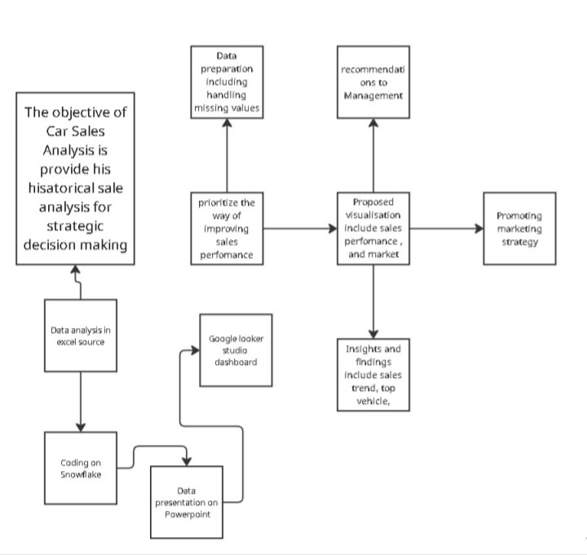
Miro Diagram

Slide 5
SQL
Using SQL queries we provided the following
Total revenue and total vehicle sold
Top selling Makes and Models
Sales performance by State
MMR and actual selling price
Effect of condition and mileage on profit
Profitable brand vehicle type

Slide 6
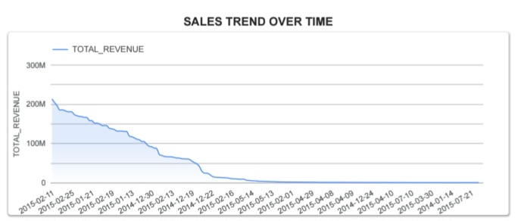
The above graph shows how total revenue changes over time.
At the beginning of the period, revenue is very high, but it gradually declines steadily as time progresses.
Sale performance is consistently dropping over the displayed period.

Slide 7
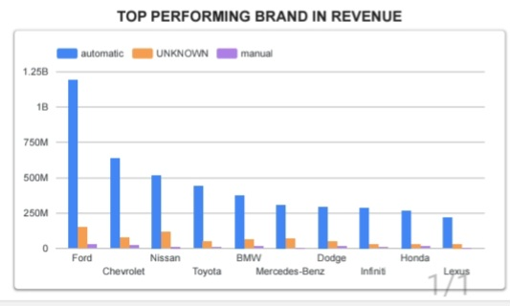
The bar chart shows the total revenue generated by each car brand, broken down by transmission type.
Ford is the highest earning brand then other brands are following.
Automatic cars clearly dominate revenue across all brands while manual and unknown contribute very little

Slide 8
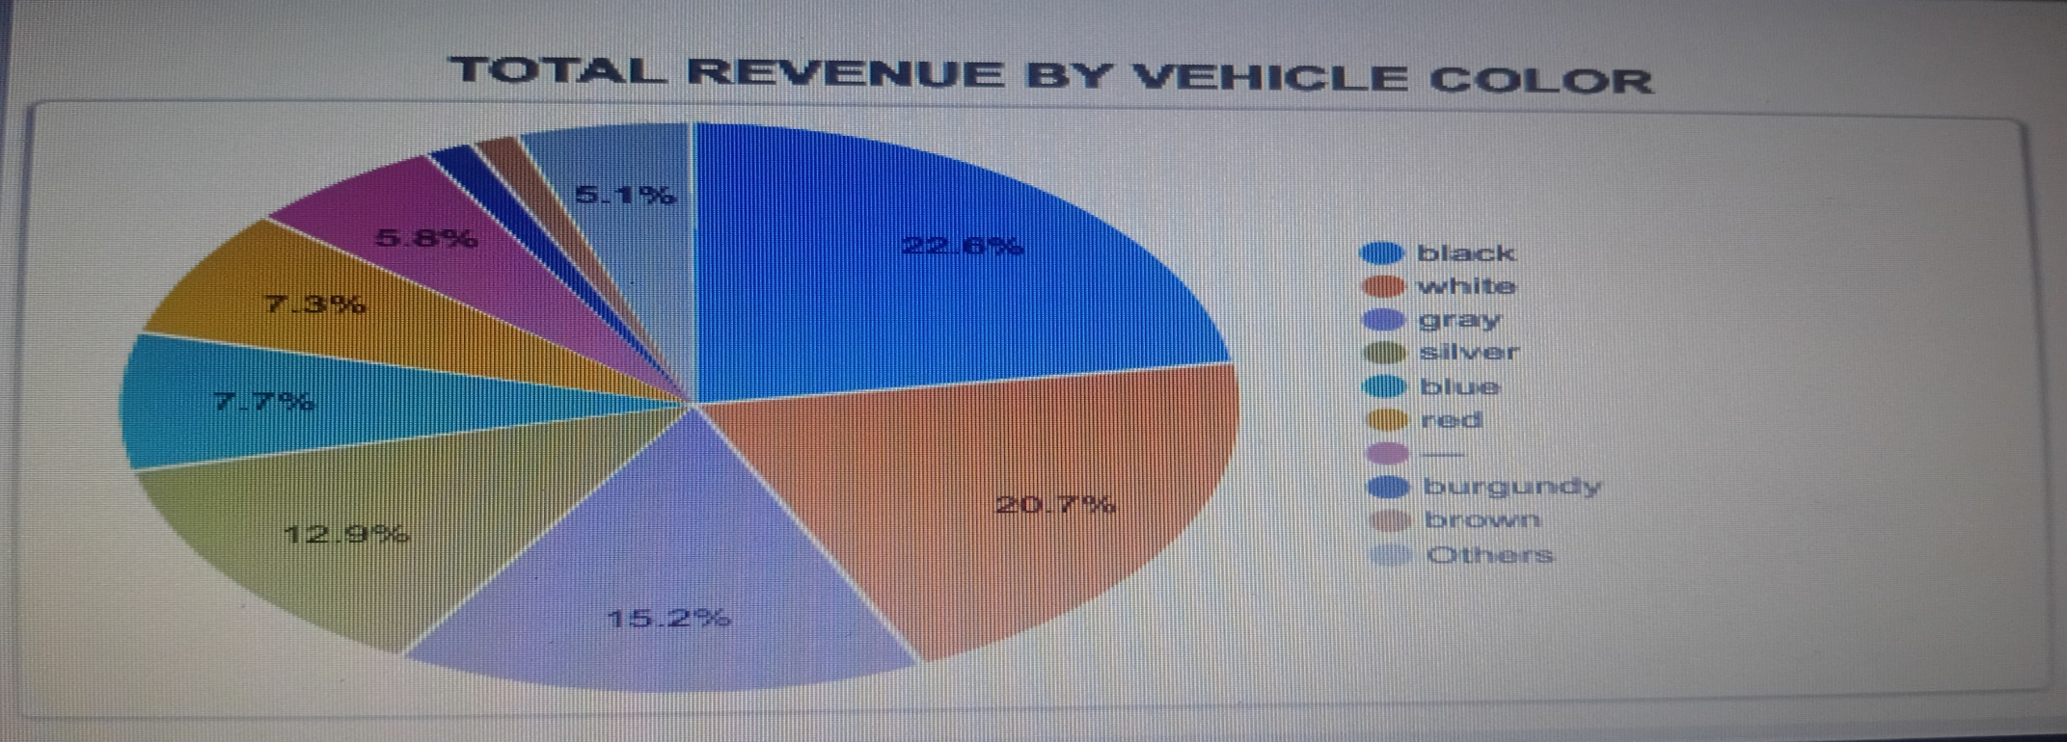
The above Pie charts shows how different vehicle colors contribute to total revenue.
Black vehicles generate the highest revenue making them the most profitable color.
Grey and Silver are second highest.
Others colors dominate sales and generate the moderate revenue.

Slide 9
RECOMMENDATIONS
The sales trend shows a continuos drop in total revenue over time.
Management should review marketing strategy, Pricing and Inventory levels to understand why sales are falling.
Prioritize high performing brands and increase stock availability, marketing focus.
Ensure the dealership stocks more automatic models to match customer demand and increase sales efficiency.
Optimize inventory based on color demand

Slide 10
THANK YOU

